Slide 1
Informatica PowerCenter
Lesson 5: Mapplets

Slide 2
Lesson Objectives
In this lesson you will learn about:
  Concept of Mapplet
  Mapplet Input and Output Transformations
  Configuring a Normalizer Transformation

Slide 3
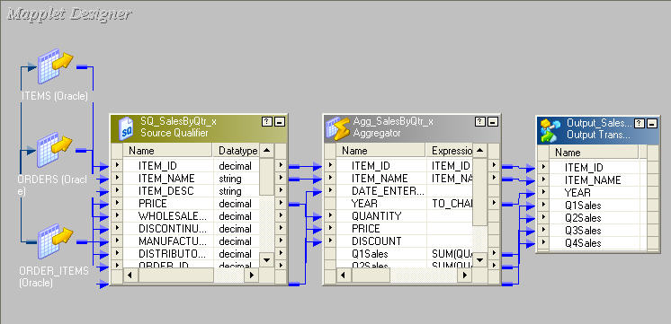
5.1. Concept of Mapplet Description
A mapplet is a reusable object that represents a set of transformations
It allows to reuse transformation logic and can contain as many transformations as needed
Figure 5.1
Notes:
A mapplet is a reusable object that is created in the Mapplet Designer. It contains a set of transformations. It allows to reuse the transformation logic in multiple mappings.

Slide 4
5.1. Concept of Mapplet
What can Mapplets do?
Mapplets help simplify mappings in the following ways:
  Include source definitions
  Accept data from sources in a mapping
  Include multiple transformations
  Pass data to multiple transformations
  Contain unused ports
Notes:
Mapplets help simplify mappings in the following ways:
Include source definitions - Multiple source definitions and source qualifiers can be used to provide source data for a mapping
Accept data from sources in a mapping - The mapplet can receive source data from the mapping by using an Input transformation to receive source data
Include multiple transformations - A mapplet can contain as many transformations as needed
Pass data to multiple transformations - A mapplet can feed data to multiple transformations. Each Output transformation in a mapplet represents one output group in a mapplet
Contain unused ports - Like a reusable transformation, a mapplet can have input and output ports that are not used in a mapping. This helps to design a mapplet for a range of uses

Slide 5
5.2. Mapplet Input and Output
Description
To use a mapplet in a mapping it has to be configured for
input and output
In addition to transformation logic a mapplet has the following components:
  Mapplet input
  Mapplet output
  Mapplet ports
Targets cannot be placed in a mapplet
It has two additional transformations
  Mapplet Input (Optional)
  Mapplet Output
Notes:
In addition to the transformation logic, a mapplet has the following components.
Mapplet input - Data can be passed into a mapplet using source definitions and/or Input transformations. An Input transformation is used to connect a mapplet to the source pipeline in the mapping
Mapplet output - Each mapplet must contain one or more output transformations to pass data from the mapplet into the mapping
Mapplet ports - Mapplet ports display only in the Mapping Designer. Mapplet ports consist of input ports from Input transformations and output ports from Output transformations. Other ports within the mapplet are referred to as transformation ports. If a mapplet uses source definitions rather than Input transformations for input, it does not contain any input ports in the mapping

Slide 6
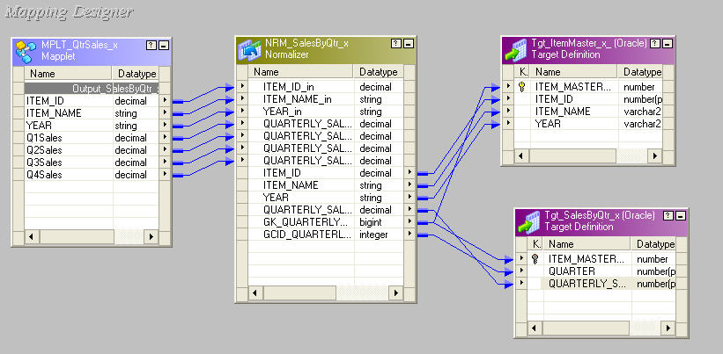
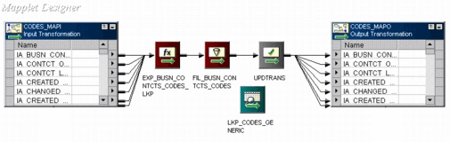
5.2. Mapplet Input and Output
Mapplet Input Transformation
A Mapplet Input Transformation is used when input has to be received from a source in a mapping.(Source definitions are in Mapping)
It provides input ports to pass data through the mapplet.
Mapplet Input Transformation
Figure 5.2
Notes:
An Input Transformation is used to receive input from a source in a mapping. When the mapplet is used in a mapping, the Input transformation provides input ports so data can be passed through the mapplet. Each port in the Input transformation connected to another transformation in the mapplet becomes a mapplet input port. Input transformations can receive data from a single active source.

Slide 7
5.2. Mapplet Input and Output
Mapplet Output Transformation
A Mapplet Output Transformation is used to pass data through the mapplet into a mapping
A mapplet must contain at least one Output transformation with at least one connected port in the mapplet
Mapplet
Output Transformation
Figure 5.3
Notes:
Every mapplet ends with a Mapplet Output Transformation. The data from the mapplet passes to the mapping through the Mapplet Output Transformation. A mapplet must contain at least one Output transformation with at least one connected port in the mapplet. Each connected port in an Output transformation displays as a mapplet output port in a mapping. Each Output transformation in a mapplet displays as an output group in a mapping. An output group can pass data to multiple pipelines in a mapping.
A mapplet can be expanded in the Mapping Designer by selecting it and choosing Mappings-Expand from the menu. This expands the mapplet within the mapping for view.

Slide 8
5.2. Mapplet Input and Output
Creating the Data Profile
After you create the mapplet to filter and aggregate the data, you can profile the mapplet output data. From the Profile Manager, create a custom profile.

Slide 9
5.3. Normalizer Transformation Description
Normalization is the process of organizing data
The Normalizer Transformation normalizes records from COBOL and relational sources
It is primarily used to create multiple rows from a single row of data
It is used instead of the Source Qualifier Transformation for a COBOL source
Notes:
Normalization is the process of organizing data. In database terms, this includes creating normalized tables and establishing relationships between those tables according to rules designed to both protect the data and make the database more flexible by eliminating redundancy and inconsistent dependencies.
The Normalizer Transformation normalizes records from COBOL and relational sources. It allows to organize the data according to the requirements. A Normalizer transformation can appear anywhere in a data flow when a relational source is normalized.
A Normalizer Transformation is used instead of the Source Qualifier Transformation when a COBOL source has to be normalized. When a COBOL source is dragged into the Mapping Designer workspace, the Normalizer Transformation automatically appears, creating input and output ports for every column in the source. COBOL sources are often stored in a denormalized format. The OCCURS statement in a COBOL file nests multiple records of information in a single record.
The Normalizer Transformation is used to break out repeated data within a record into separate records. For each new record it creates, the Normalizer Transformation generates a unique identifier. This key value is used to join the normalized records. The Normalizer Transformation can also be used with relational sources to create multiple rows from a single row of data.

Slide 10
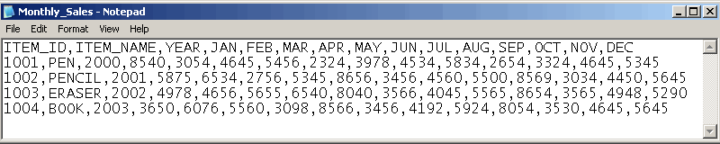
5.3. Normalizer Transformation
Sample Source Data
Item-wise monthly sales for each year
Figure 5.4
Notes:
In the above example, the source flat file contains the year-wise, monthly sales information in one row. The objective is to split this one row of data into multiple rows to get sales information by month.

Slide 11
5.3. Normalizer Transformation
Operations Performed
A unique key called GKID is created for each new record.
The Designer generates one column (port) for each OCCURS clause specified in the Normalizer tab to specify the positional index within an OCCURS clause.
A column id by the name GCID_occurring_field_name is generated for each OCCURS port.
Notes:
The first step, after bringing in the source definition, would be to create a Normalizer Transformation. Ports must be manually added under the Normalizer tab – they cannot be dragged from other transformations. Defining the output records structure here automatically creates the input ports that are required to create the desired output. The value in the Occurs column of the Normalizer tab designates the number of repeated ports created in the Ports tab.

Slide 12
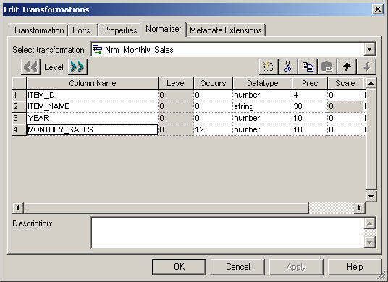
5.3. Normalizer Transformation
Normalizer Tab
Repeating 12 times in the source file
Figure 5.5
Notes:
In the above example, the monthly sales will have the occurs value as 12.

Slide 13
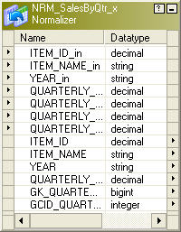
5.3. Normalizer Transformation
Generated Keys
GKID
GCID
Figure 5.6
Notes:
For each new record it creates, the Normalizer transformation generates a unique identifier called GKID_occurring_field_name. This key value can be used to join the normalized records.
The Designer also generates one column (port) for each OCCURS clause in the source file to specify the positional index within an OCCURS clause. The naming convention for the Normalizer column ID is: GCID_occurring_field_name.

Slide 14
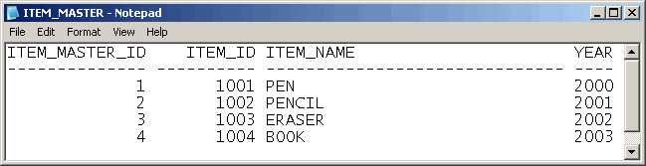
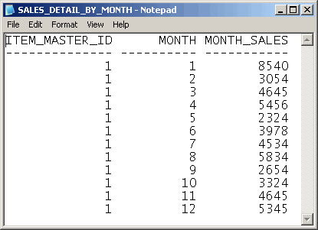
5.3. Normalizer Transformation Output
Figure 5.7
GKID_MONTHLY_SALES
GCID_MONTHLY_SALES
Figure 5.8
Notes:
As shown in the above Figure 5.7, this generated unique key is GKID_MONTHLY_SALES and the generated column id is GCID_MONTHLY_SALES for each OCCURS in the source. The Normalizer ID columns informs about the order of records in an OCCURS clause. For example, if a record occurs two times, when the Workflow is run, the Integration service numbers the first record 1 and the second record 2. The Normalizer column ID is also useful to pivot input columns into rows.

Slide 15
Summary
After completing this lesson you now:
  Know how to configure a Mapplet using:
    Mapplet Input Transformation
    Mapplet Output Trasformation
  Know how to configure a Normalizer Transformation

Slide 16
Review Question
Question 1: Mapplets are configured using the ____________.
Question 2: A mapplet cannot have ________ definitions.
Question 3: A Normalizer Transformation can be used for COBOL, VSAM and relational sources.
True/False
Question 4: GKID is a unique key generated for each column with the OCCURS clause.
True/False

